Slide 1
Prediction of Protein-Protein Interations by Docking Methods
Speaker: 孫嘉璘
Advisor:楊昌彪老師

Slide 2
Outline
Characteristics of protein-protein interactions
Forces that mediate protein-protein interactions
Methods that aim to predict the structure in atomic detail
Future directions and conclusions

Slide 3
Characteristics
Protein-protein interaction can be classified by :
1.Proteins involved (structureal or functional
groups)
2.Physical properties (weak/transient/non-obligate
vs. strong/permanent/obligate)
3.Cause protein interactions usually mediated by
defined domains, we can classify interaction
based on the underlying domains

Slide 4
Cont.
Even simple single-celled organism have roughly 6000 proteins interact by at least 3 interactions per protein. Infer that there may be on the order of ~100,000 interactions in human body
Most protein-protein interaction are detected as interacting pairs or as components of protein complexes. (Such complexes may contain dozens or hundreds of protein subunits)

Slide 5
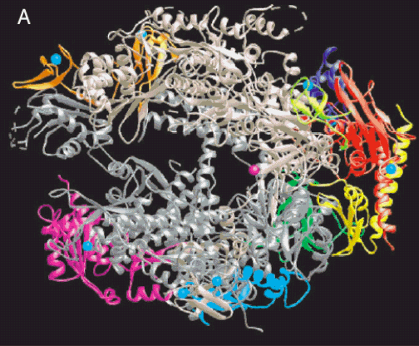
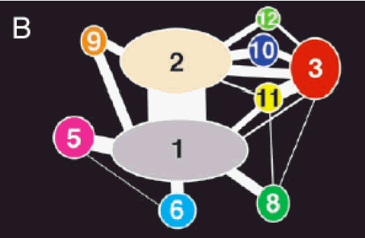
Example of Representation Interaction
The thickness represent of the surface area buried in the corresponding subunit interface
Ref [1]

Slide 6
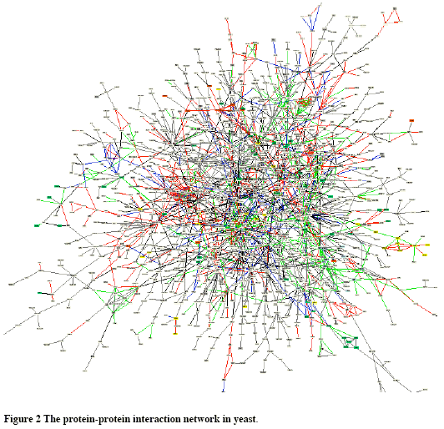

Slide 7
Forces that Mediate Protein-Protein Interactions
Hydrogen bonds (about 1 per 170Å² buried surface)
Van der Waals interations (occurs between all neighboring atoms)
Electrostatic interactions
Hydrophobic effects

Slide 8
Methods that Aim to Predict the Structure in Atomic Detail
Accurate predictive docking methods could provide substantial structural knowledge about complexes.
Target : the conformational change in docking is fairly small → enable the use of methods based on shape and chemical complementarity of the unbound components ( this can be considered as “canonical case” of protein-protein docking )

Slide 9
Cont.
1.Global search: one widely used technique of docking is the fast Fourier transform the molecules are discretised onto a voxel grid. Using some molecular docking programs which has proved successful in blind trials of protein docking.
(hundred or thousand docked complexes will occur after this step)

Slide 10
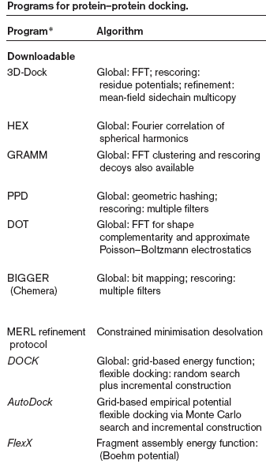
Ref [2]

Slide 11
Cont.
2.Rescoring: one way is to use the statistics of residue-residue contacts across the interfaces of complexes between residues with the observed global frequencies of occurrence
3.Introduction of flexibility: the rigid-body approximation is abandoned, sidechain is considered. A common way to simplify the search is to restrict to sampling the known populated rotamers of the sidechains

Slide 12
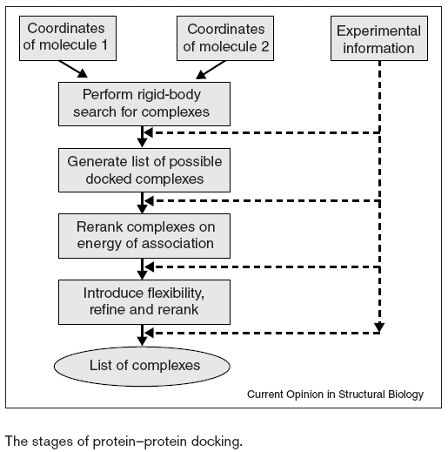

Slide 13
Future Directions and Conclusions
The protocol of fast docking followed by rescoring and refinement is well established. Without biological info, it is still difficult to get the near-native complex form unbound components
Ideas from the kinetics of binding and the role of binding funnels provide insight, and are already beginning to have a practical effect on docking algorithms

Slide 14
Reference
[1] Prediction of protein-protein interactions by docking methods, Graham R Smith and Michael JE Sternberg, Current Opinion In Structural Biology, pp.28-35, 2002
[2] Protein-Protein Interaction, Peter Uetz and Carolina S. Vollert, Encyclopedic Reference of Genomics and Proteomics in Molecular Medicine, 2003
[3] Photorealistic Object Reconstruction Using Voxel Coloring and Adjusted Image Orientations, Technical University of Berlin

Slide 15
Voxel Grid
Voxel (Volume Pixel) :A 3-D element that describes the data in a volumetric structure
相對於普通相素，voxel包含了更多資訊可幫助系統有效的降低鋸齒現象

Slide 16
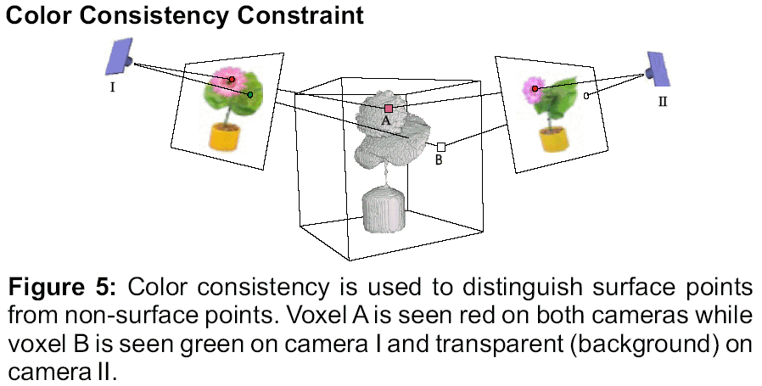
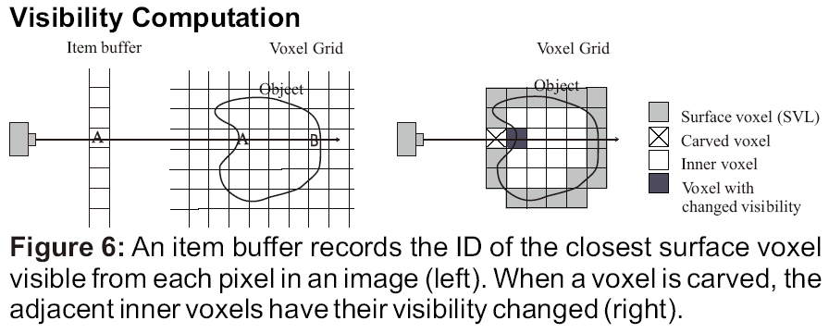
Cont.
Ref [3]

